Slide 1

NatWest Investment Tracker (NIT) - Be The Smarter Investor

Slide 2

Team Players
Swetha C
Surendiran Veeramani
Riduvarshini Uvaraj Latha

Slide 3

Roadmap
Abstract Statement​
Architecture Diagram​
Specifications
Application Demo​
Tech Stack
Microservices Overview
Docker
​Test Scripts
Code Coverage​
Gratitude

Slide 4

Abstract Statement:
Design a platform for customer’s wealth management and investments in stocks as well as educate the customers regarding ESG (Environmental Social and Governance) regarding stocks.
Customers can use the app to get a view of all the current stocks and values.
The app can be further extended to manage personal wealth. Portfolio watcher is an application where users can view the up-to-date live prices of every stock.
Users will also be able to see his/her transaction history.

Slide 5
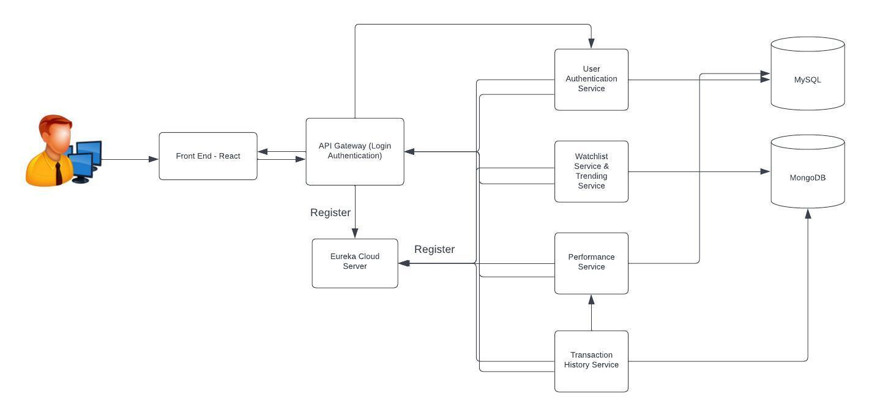
Architecture Diagram

Slide 6

Specifications
Portfolio management.
Real-time market data.
Investment performance analysis.
Customizable alerts.
Security and privacy measures.

Slide 7

Application Demo

Slide 8










Slide 9
Microservices Overview
User Authentication
Watchlist service & Trending Service
Performance Service
Transaction History Service

Slide 10

User Authentication Microservice:
Responsible for user registration, login, and authentication.
Manages user profiles and credentials.
Encrypted password is saved in database.
Transaction History Microservice:
Records user transactions, including stock purchases and sales.
Maintains transaction history for each user.

Slide 11
Watchlist & Trending Microservice:
Allows users to add stocks to their watchlist.
Retrieves and displays live stock prices and ESG ratings for the stocks in the watchlist.
Performance Microservice:
Allows users to create and manage their investment portfolios.
Tracks individual investments(Stock).
Providing real-time or periodic updates on portfolio performance.

Slide 12
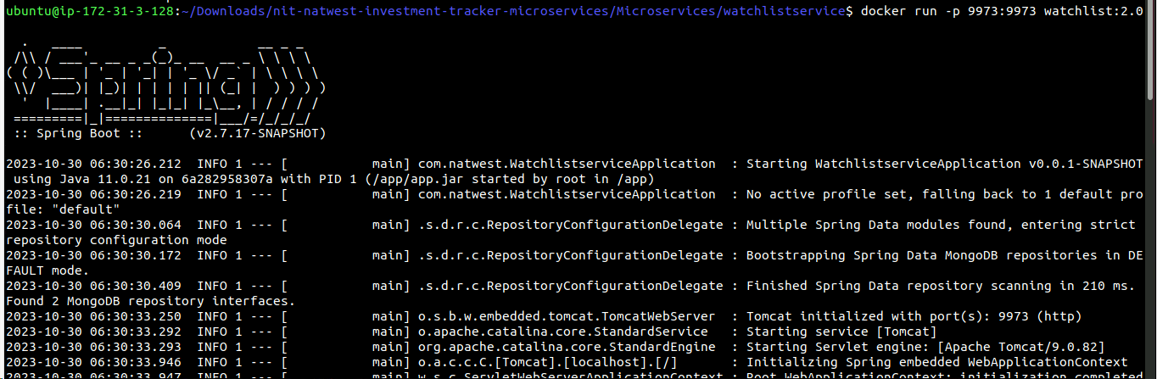
DOCKER

Slide 13

Test Scripts
This Photo by Unknown author is licensed under CC BY-SA-NC.

Slide 14
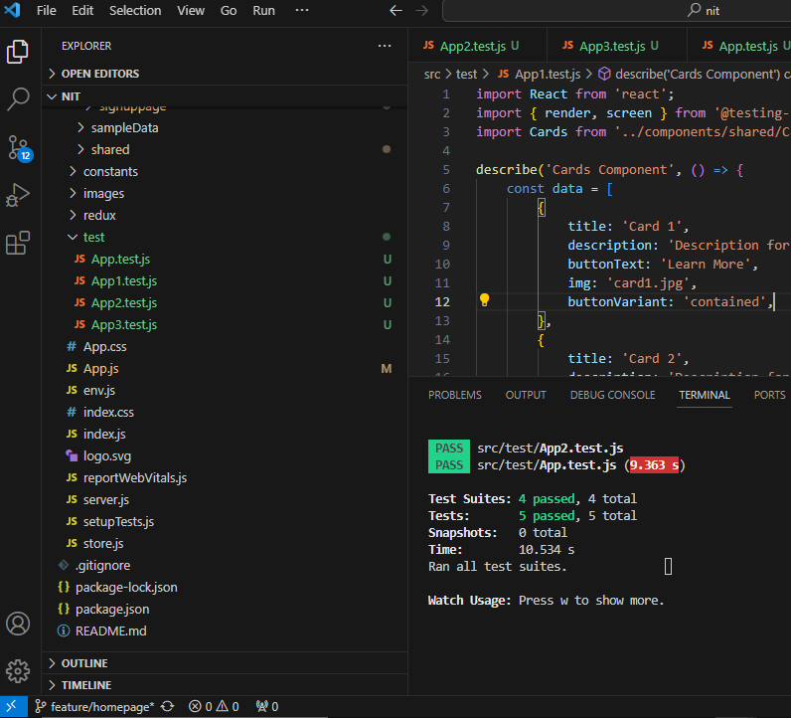
Front-end Test Scripts
Total 5/5 test cases passed.
Tools: React testing Library

Slide 15

Back-end Test Scripts

Slide 16
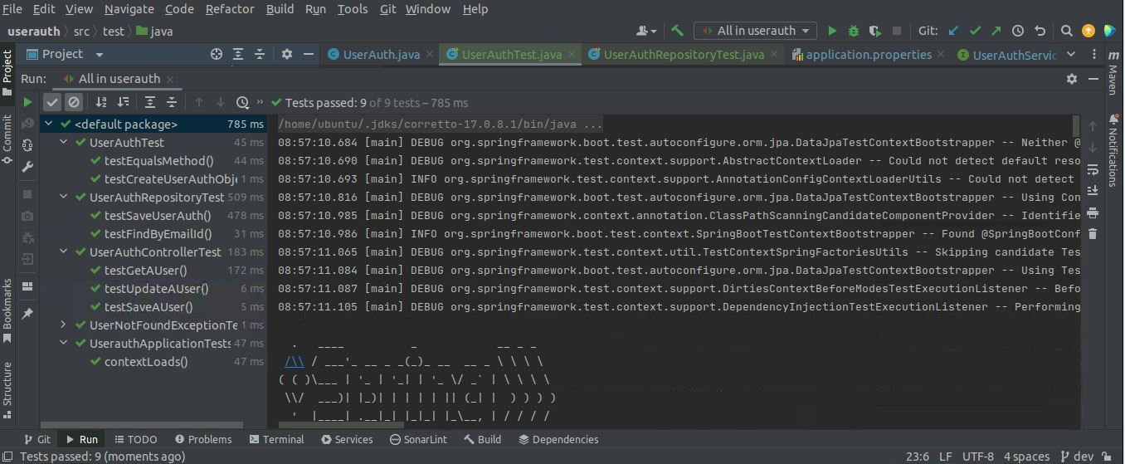
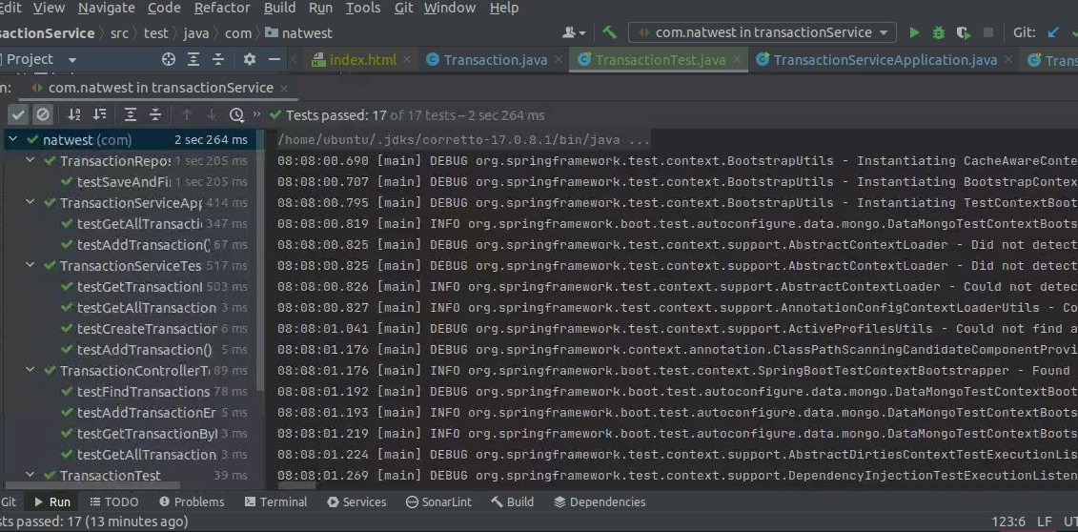
UserAuth and Transaction Microservice
Total 9/9 test cases passed in UserAuth microservice.
Total 17/17 test cases passed in Transaction history microservice.
Tools: Java Code Coverage (JACOCO) used for transaction service.

Slide 17
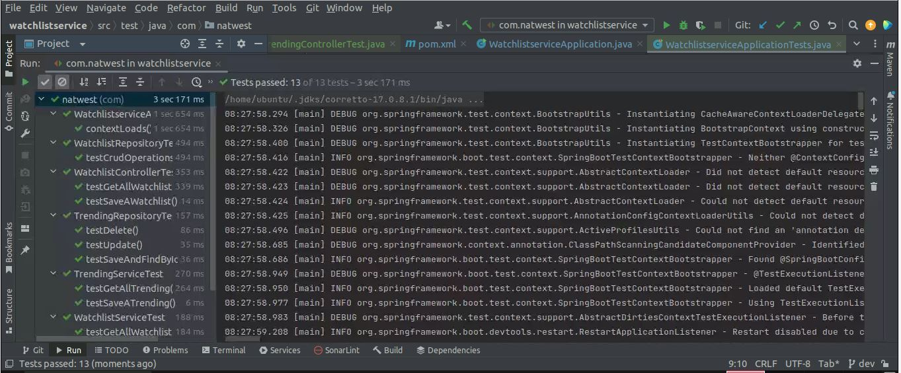
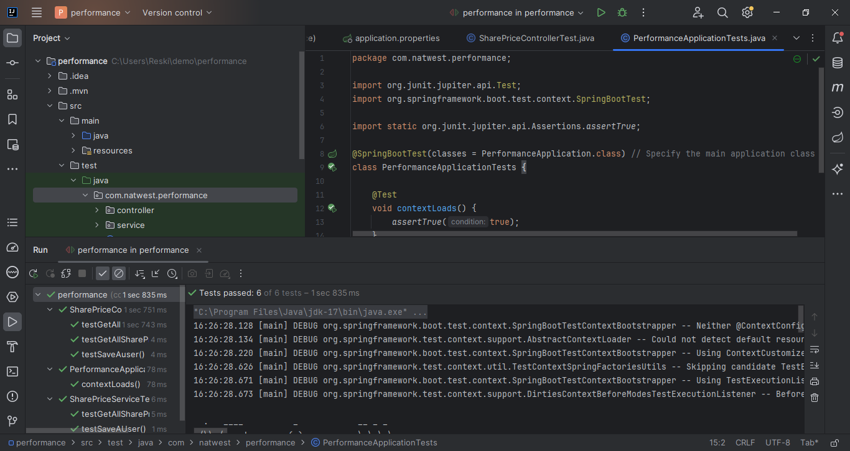
Watchlist and Performance Microservice
Total 13/13 cases passed in watchlist microservice.
Total 6/6 test cases passed in Transaction history microservice.
Tools: Junit

Slide 18
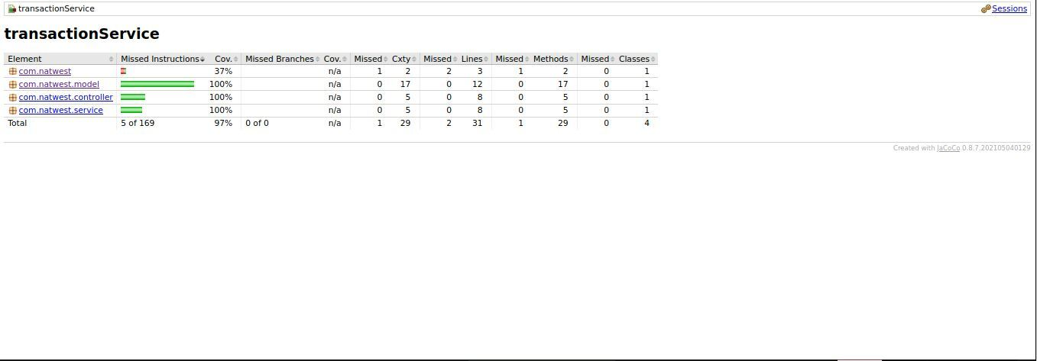
Code Coverage

Slide 19

NatWest reskilling academy team.
Stackroute Mentor:
Dayananda Rao
Special thanks to our NatWest mentors for the guidance and support.
Balaji Mandapati
Umendar Koosam
John Britto Lawrence
This Photo by Unknown author is licensed under CC BY.

